Slide 1
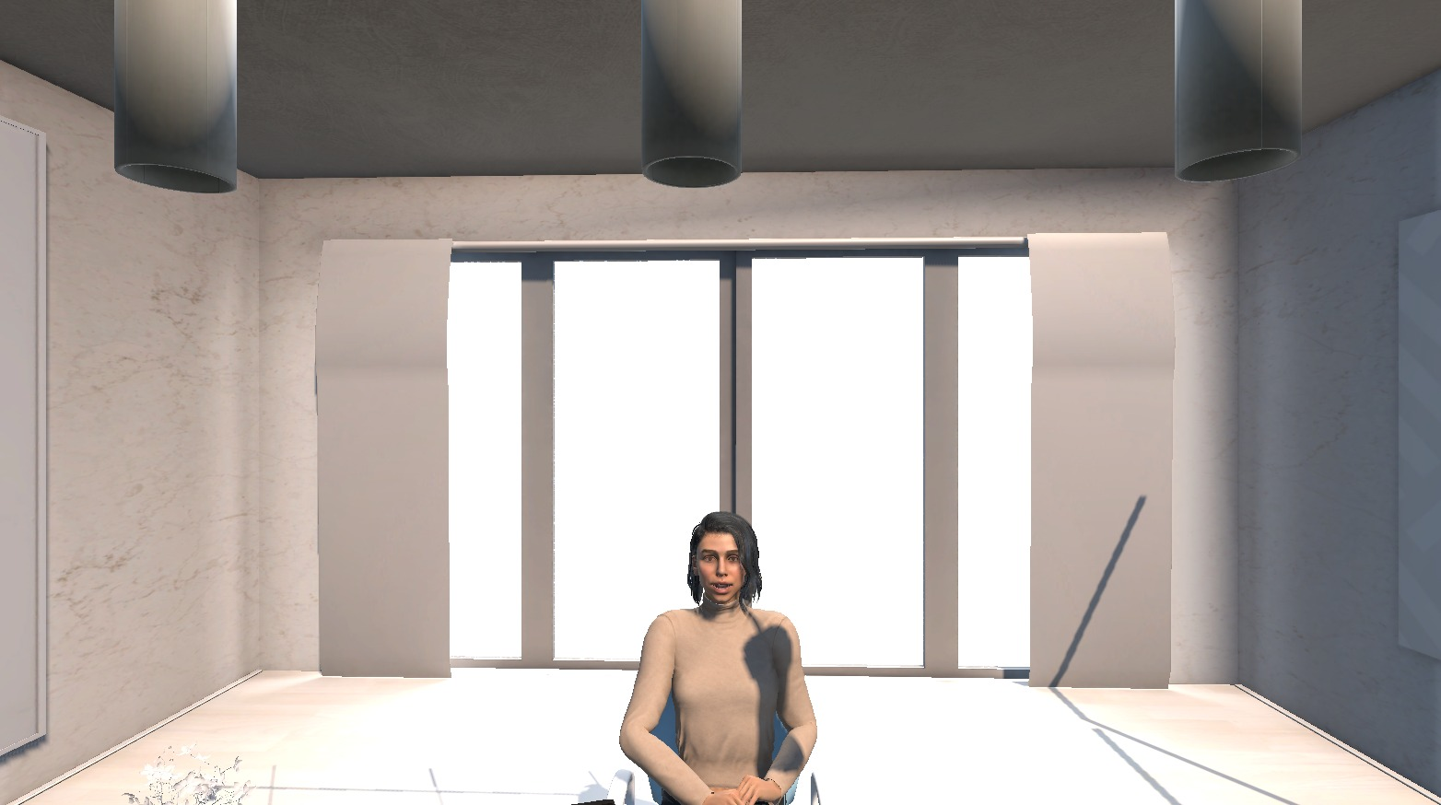
DESIGN THINKING ()
AI POWERED VR
MOCK-INTERVIEW
SIMULATION
A resume-grounded, sequential multi-persona conversational AI framework for immersive interview practice
Virtual interview panel built in Unity
SWETHA N
MUKESH VA
3 sequential AI interview stages
241701059
241701034
Project Guide: Dr. P. Revathy, Professor
Department of Computer Science and Design
Rajalakshmi Engineering College, Thandalam, Chennai
Notes:
Good morning everyone. We are Swetha and Mukesh, and today we are presenting our project, AI Powered VR Mock-Interview Simulation, done under the guidance of Dr. P. Revathy in the Department of Computer Science and Design. In short, it is a virtual reality interview room where three AI interviewers, an HR, a behavioural interviewer and a hiring manager, interview a student based on that student's own resume.

Slide 2

PROBLEMS TO BE SOLVED
OBJECTIVES
Existing challenges
1
Immersive environment: Unity + OpenXR
No personalised questions
No realistic interview environment
Hard to practise multiple interviewer roles
Inconsistent performance feedback
2
Extract candidate details from PDF resumes
3
Voice-based conversational AI interaction
4
Three sequential stages: HR, behavioural, hiring manager
5
Analyse head orientation, posture, response latency
6
Automated feedback and downloadable PDF reports
7
Placement dashboard for performance access
Notes:
Our problem statement is simple. Traditional interview preparation does not give personalised questions, a realistic setting, or consistent feedback, and students find it hard to practise with different interviewer roles. To address this we set seven objectives, shown on the right: build the VR environment, extract details from the resume, add voice AI, run three interview stages, monitor basic behaviour, generate feedback and a PDF report, and connect everything to a placement dashboard.

Slide 3



Why VR + AI for interview practice
VR and AI enable interactive learning
Immersive environments plus conversational AI make practice realistic and personalised.
Virtual
Reality
Conversational
AI
Traditional mock interviews are limited
They depend on interviewer availability and give inconsistent feedback.
Students need repeatable practice
Immersive, resume-based interview practice
A realistic place to practise before placement interviews, as many times as needed.
Notes:
Virtual reality and AI are already being used for interactive learning and training. Interview preparation is a very important part of a student's career, but normal mock interviews depend on whether a trainer is available, and the feedback is not always consistent. So students need a place where they can practise again and again in a realistic setting. Our project combines VR and conversational AI to give exactly that.

Slide 4




c
From limited practice to an integrated platform
Existing approaches
Proposed system
Personalisation
Limited resume-based questions
Resume-grounded questions
Environment
Video-based practice, not immersive
Unity + OpenXR VR with desktop fallback
Interviewers
Few roles, no continuous multi-stage flow
3 sequential AI interviewers with transcript continuity
Feedback
Depends on trainer availability
Behavioural indicators, PDF report, dashboard
Notes:
Here we compare existing approaches with our system. Existing methods are traditional mock interviews, online platforms and some AI tools. They usually offer limited resume-based personalisation, no immersive environment, few interviewer roles and inconsistent feedback. Our system puts all of this in one platform: questions based on the candidate's resume, an immersive VR room with a desktop option, three interviewers in sequence, and a PDF report plus dashboard at the end.

Slide 5
Six connected layers
USER INTERACTION
Candidate
Resume upload
Unity Application
Interview start
VR / Desktop Mode
User interface
RESUME PROCESSING
PDF Parser (Python)
Text extraction
Candidate Profile
Skills, education, projects
VR ENVIRONMENT
Unity 6
3D interview room
OpenXR / VR SDK
VR headset or desktop
CONVERSATIONAL AI
HR Interviewer
Convai
Behavioural Interviewer
Convai
Hiring Manager
Convai
FEEDBACK & REPORTING
Evaluation Module
Heuristic analysis
Performance Summary
Scores, feedback
PDF Report
ReportLab
PLACEMENT DASHBOARD
Backend API
Node.js + Express
Database
PostgreSQL + Prisma
Placement Dashboard
Next.js
Notes:
This is the overall architecture, drawn from our report. It flows from top to bottom. The candidate uploads a PDF resume, the Python parser builds a candidate profile, and Unity with OpenXR runs the interview room. Inside it, Convai powers the three interviewers. During the session we record head orientation, posture stability and response latency. After the interview, the evaluation module creates the summary and a PDF report with ReportLab. Finally the Node and Express backend stores results in PostgreSQL through Prisma, and the Next.js placement dashboard displays them.

Slide 6







Our technology stack
Unity 6
OpenXR
Convai
Python + pypdf
Builds the VR interview environment and manages interview flow
Enables VR headset support, with desktop fallback
Voice-based conversations with virtual interviewers
Extracts text from PDF resumes to build the profile
Node.js + Express
Next.js
PostgreSQL + Prisma
ReportLab
Backend REST API linking Unity to the dashboard
Interface of the institutional placement dashboard
Stores and manages interview results data
Generates the downloadable PDF performance report
Notes:
These are the technologies we used and the role of each. Unity 6 builds the VR interview room, and OpenXR adds headset support with a desktop fallback. Convai handles the voice conversation with the virtual interviewers. Python with the pypdf library reads the resume. Node.js and Express form the backend API, Next.js is the dashboard interface, PostgreSQL with Prisma stores the data, and ReportLab creates the PDF report.

Slide 7



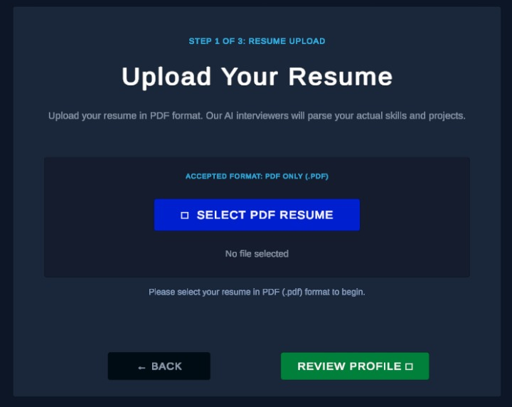
c
From PDF resume to personalised questions
1 Upload
2 Extract
3 Parse
4 Profile
Candidate uploads a PDF resume
Python + pypdf read the text
Regex and keyword heuristics
Structured candidate profile
PROFILE USED TO PERSONALISE THE INTERVIEW
Skills
Education
Projects
Experience
HR stage: general and resume-related questions
Hiring-manager stage: project and role-related questions
Accuracy depends on the PDF's text structure
Resume upload interface (PDF only)
Notes:
The interview starts with the resume. The candidate uploads a PDF, as you can see in our actual interface. A local Python component extracts the text using the pypdf library, then applies regular expressions and keyword rules to find skills, education, projects and experience. This becomes the candidate profile, and the interview questions are based on it. One honest limitation: since we use text extraction and rules, accuracy depends on how the PDF is structured.

Slide 8



c
Three interview stages, one continuous conversation
~200 s
~200 s
~200 s
STAGE 1
transcript
STAGE 2
transcript
STAGE 3
HR Interview stage
Behavioral stage
Hiring Manager stage
Introduction, background, general and resume-related questions
Past experiences, problem-solving, situational questions
Skills, project experience, role-related questions
PLANNED SESSION TIMELINE
HR 200 s
Behavioral 200 s
Hiring Manager 200 s
Total planned duration: 600 seconds | Stage transcript forwarded to the next interviewer
Notes:
This is the heart of the system. The interview runs in three stages, one after another. First the HR interviewer asks about your background and resume. Then the behavioural interviewer asks situational questions about past experiences. Finally the hiring manager asks about skills, projects and the role. Each stage runs for about 200 seconds, so the planned interview is 600 seconds. The key point is continuity: when one stage ends, its transcript is passed to the next interviewer, so the conversation feels like one continuous interview.

Slide 9
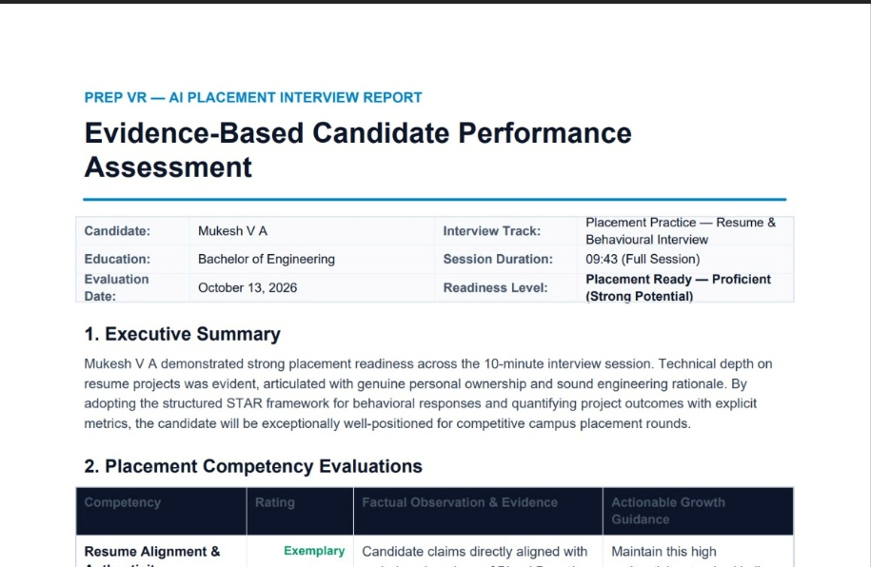



c
From interview data to actionable feedback
10
competency-based evaluation areas, scored with heuristic rules
Heuristic evaluation of transcripts and behavioural indicators
On-screen performance summary
Downloadable PDF report using ReportLab
Results synced to the placement dashboard via REST API
Generated report: executive summary and competency table with rating, evidence and growth guidance
Scores are engineering heuristics, not yet validated by formal user studies. Treat them as practice feedback.
Notes:
After the interview, the evaluation module uses heuristic rules over ten competency areas, using the transcripts and the behavioural indicators. The result is shown on screen and also saved as a PDF report generated with ReportLab. You can see our actual report on the right, with an executive summary and a competency table. The same results can be synced to the placement dashboard through a REST API. Please note the scoring is heuristic and has not been validated by user studies yet, so it is meant as practice feedback.

Slide 10
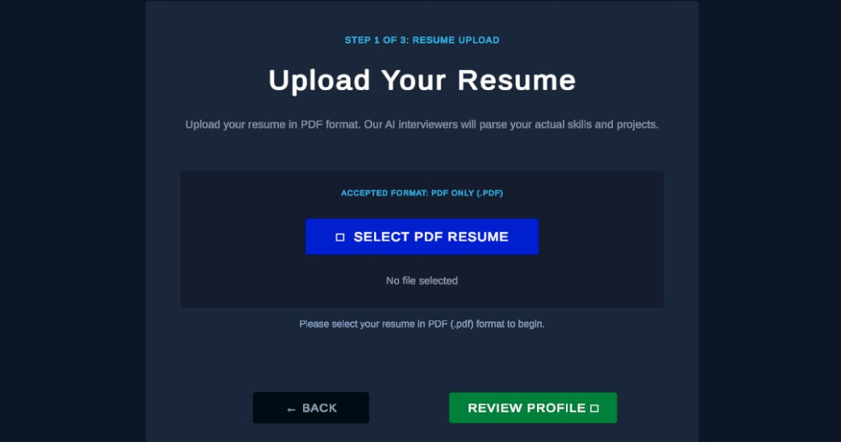
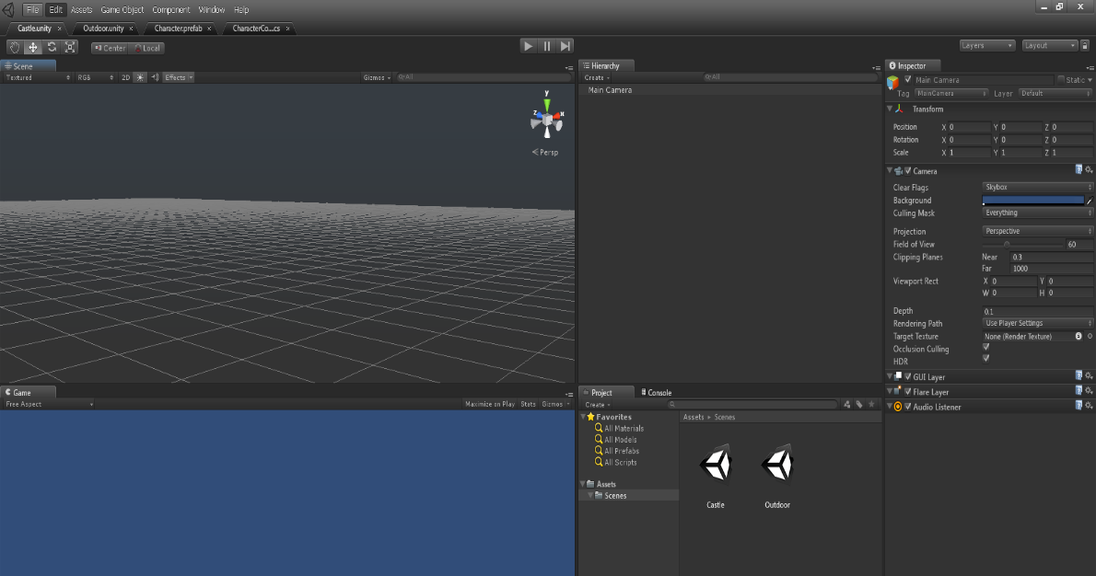
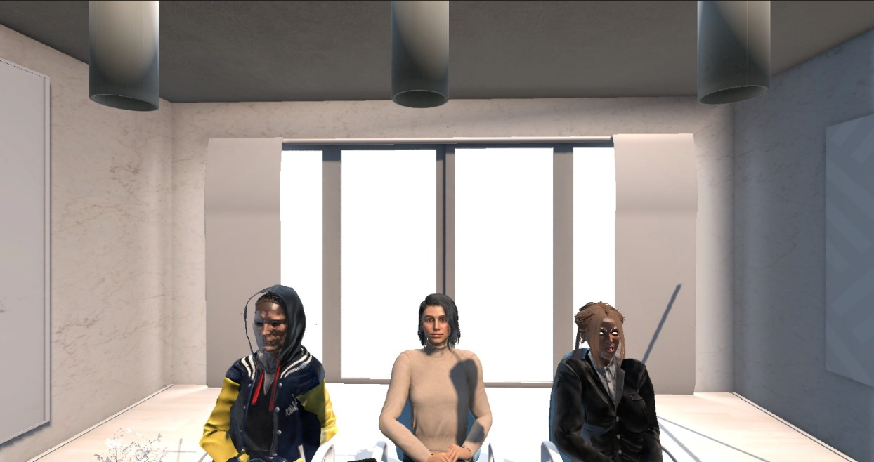
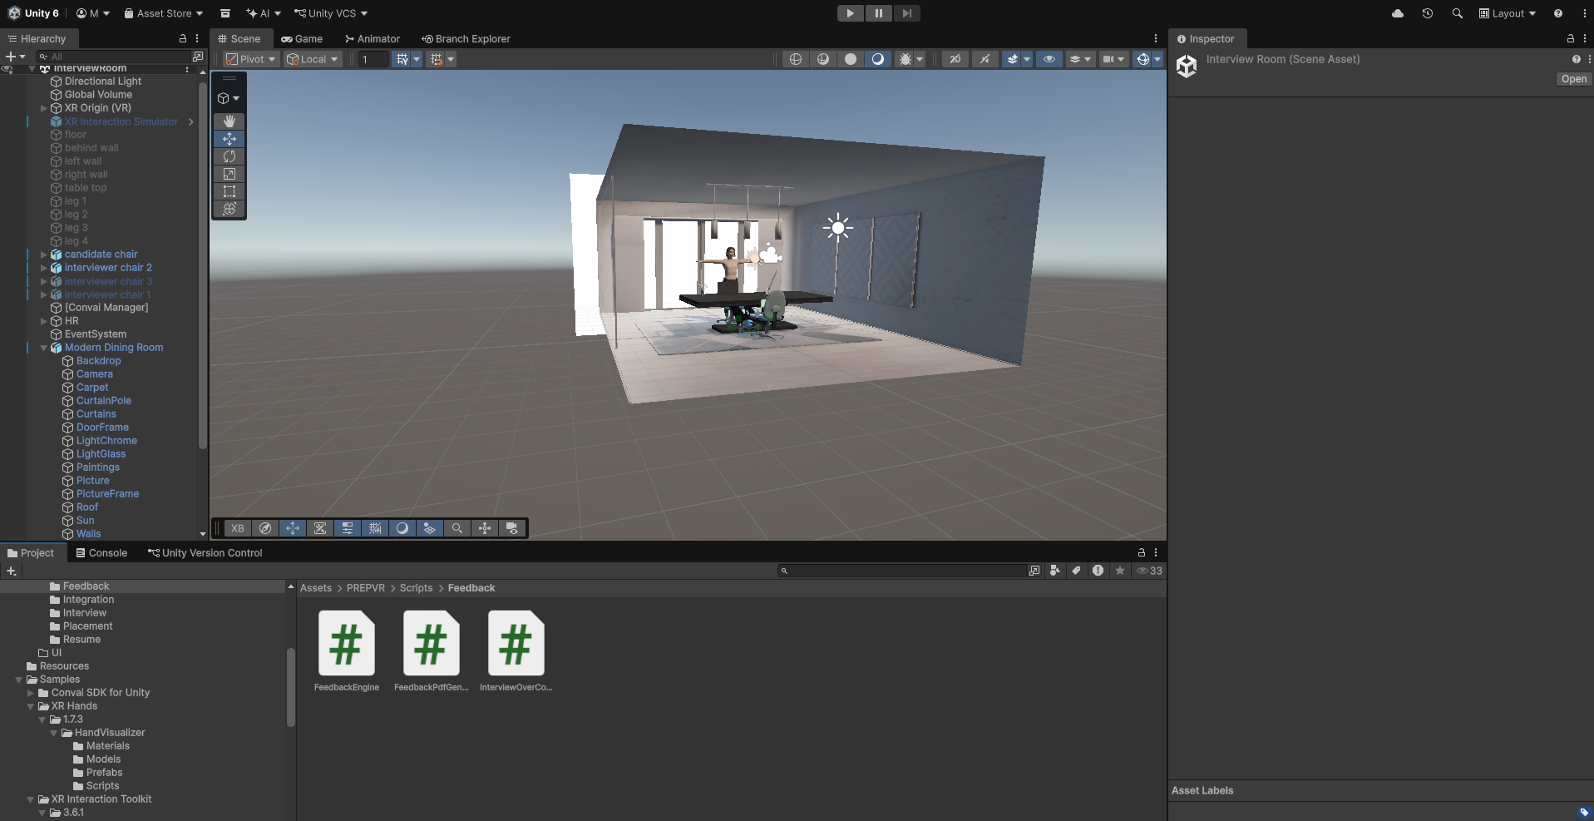
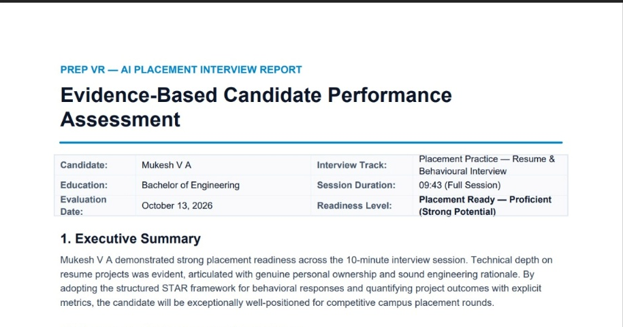
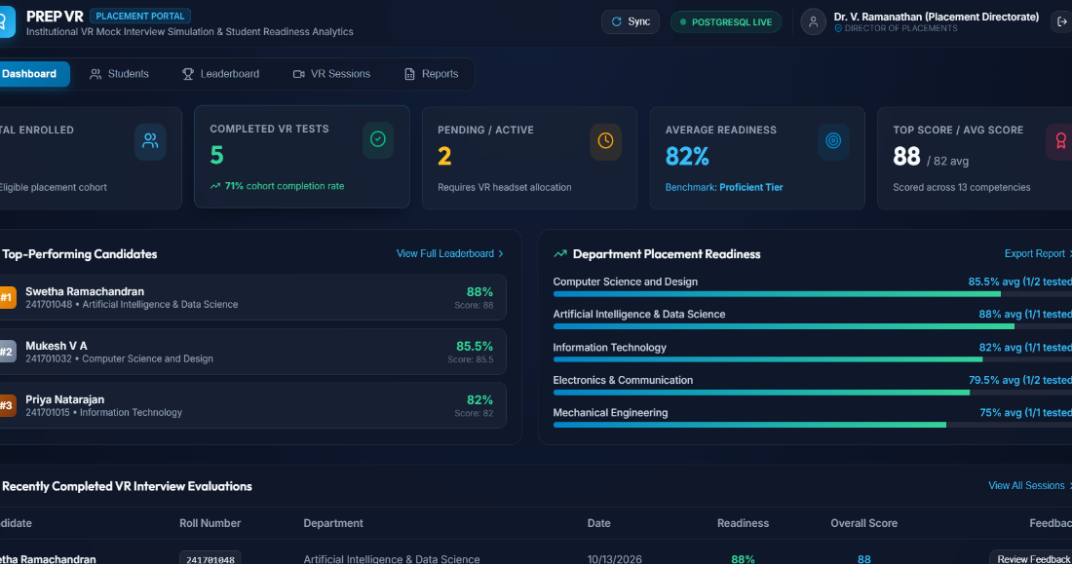


c
The implemented system
c
1 Resume upload interface
2 Unity environment
3 VR interview environment
RESULTS
End-to-end workflow integrated
Three-stage interview, PDF report, dashboard sync
User studies still pending
4 Feedback report
5 Placement dashboard
Notes:
These are screenshots from our actual implementation, not mock-ups. First, the resume upload screen. Second, the Unity environment. Third, the VR interview room with the three interviewers. Fourth, the generated feedback report. Fifth, the placement dashboard. Together they show the complete workflow working from resume to dashboard. Technically the system is integrated, but we have not yet done formal user studies, so we do not claim improvements in confidence or interview outcomes.

Slide 11
c
What we achieved and where next
c
SDG CONTRIBUTION
IMPLEMENTED
FUTURE SCOPE
4
SDG 4 | Primary focus
VR + conversational AI + resume processing in one framework
Three sequential interviewers with transcript continuity
Heuristic scoring, PDF report, dashboard sync
User studies to validate scoring
Technical coding interview track
Eye-tracking hardware support
Wider resume layouts, more personas
Interview history and progress tracking
Quality Education
9
SDG 9
Industry, Innovation and Infrastructure
8
SDG 8
Decent Work and Economic Growth
Thank you
Notes:
To conclude, we built one framework that brings together VR, conversational AI, resume processing, behavioural monitoring, PDF reporting and a placement dashboard, with three interviewers running one after another. We are also clear about limitations: the scoring is heuristic and has not been validated with users. In future we want to run user studies, add a technical coding track, support eye tracking hardware, handle more resume layouts, and add interview history and progress tracking. The project mainly supports SDG 4 Quality Education, and also SDG 9 Industry, Innovation and Infrastructure, and SDG 8 Decent Work and Economic Growth. Thank you, and we are happy to take questions.

